Slide 1
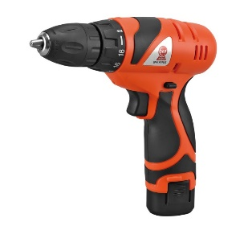
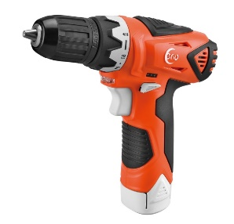
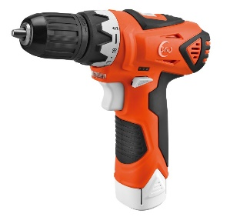
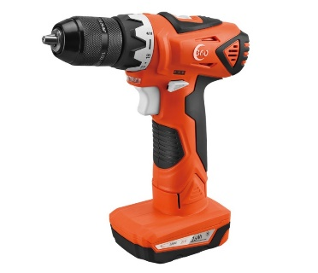
CORDLESS DRILL SERIES COMPACT MODEL
SPECIFICATION | 8101 | 8105 | 8106 | 8104
Volts | 12V MAX | 12V MAX | 12V MAX | 20V MAX
Speed Setting | 1 | 1 | 2 | 2
Max Rpm | 0-650 rpm | 0-600 rpm | 0 - 400 / 1,400 rpm | 0 - 400 / 1,400 rpm
Chuck size | 10mm (3/8") Keyless | 10mm (3/8") Keyless | 10mm (3/8") Keyless | 10mm (1/2") Keyless
Max Torque | 0-19Nm | 0-22Nm | 0-13/30Nm | 0-18/40Nm
Charger/Batteries | 1 Hour charger / 1.5Ah Lithium-ion battery （1） | 1 Hour charger / 1.5Ah Lithium-ion battery （1） | 1 Hour charger / 1.5Ah Lithium-ion battery （1） | 1 Hour charger / 1.5Ah Lithium-ion battery （1）
Includes | BMC | BMC | BMC | BMC
Net Weight (With Battery) | 0.95Kg / 2.1 Lbs | 1.05Kg / 2.3 Lbs | 1.1 Kg / 2.4 Lbs | 1.2 Kg / 2.6 Lbs
Features | Most Compact and light duty model | Fuel Level indicator Improved Wide Angle illumination Same engineer deisgn as Bosch PS 31 | Fuel Level indicator Advanced two speed gearbox, torque 40% Improved Wide Angle illumination Same engineer deisgn as Bosch PS 31 | Fuel Level indicator Advanced two speed gearbox, torque 40% Improved Wide Angle illumination Same engineer deisgn as Bosch PS 31
(PRO1.5Ah Battery)
(DIY 1.3Ah Battery)

Slide 2
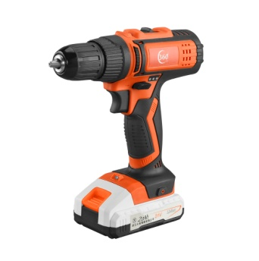
CORDLESS DRILL SERIES 20.19 Models
SPECIFICATION | 8112 | 8116 | 8118
Volts | 12V MAX | 16V MAX | 20V MAX
Speed Setting | 2 | 2 | 2
Max Rpm | 0 - 400 / 1,400 rpm | 0 - 400 / 1,400 rpm | 0 - 400 / 1,400 rpm
Chuck size | 10mm (3/8") Keyless | 10mm (3/8") Keyless | 10mm (1/2") Keyless
Max Torque | 0-13/30Nm | 0-16/35Nm | 0-18/40Nm
Charger/Batteries | 1 Hour charger / 1.5Ah Lithium-ion battery （1） | 1 Hour charger / 1.5Ah Lithium-ion battery （1） | 1 Hour charger / 1.5Ah Lithium-ion battery （1）
Includes | BMC | BMC | BMC
Net Weight (With Battery) | 1.2 Kg / 2.6 Lbs | 1.3 Kg / 2.8 Lbs | 1.4 Kg / 3.0 Lbs
Features | DEWALT PATTERN HOUSING Fuel Level indicator Advanced two speed gearbox, torque 40% Improved Wide Angle illumination Same engineer deisgn as DEWALT | DEWALT PATTERN HOUSING Fuel Level indicator Advanced two speed gearbox, torque 40% Improved Wide Angle illumination Same engineer deisgn as DEWALT | DEWALT PATTERN HOUSING Fuel Level indicator Advanced two speed gearbox, torque 40% Improved Wide Angle illumination Same engineer deisgn as DEWALT
(PRO1.5Ah Battery)
(DIY 1.3Ah Battery)

Slide 3
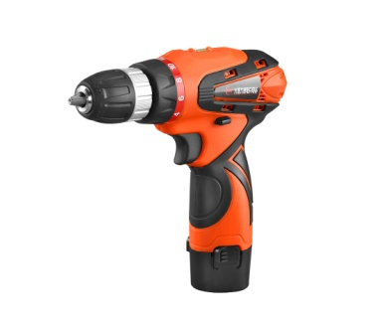
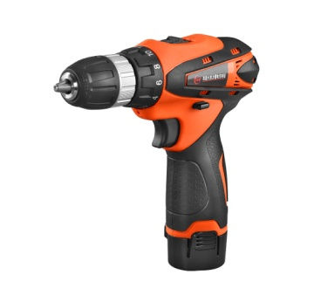
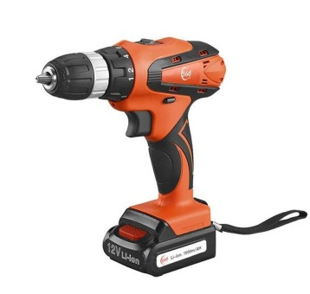
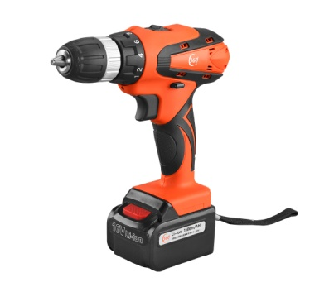
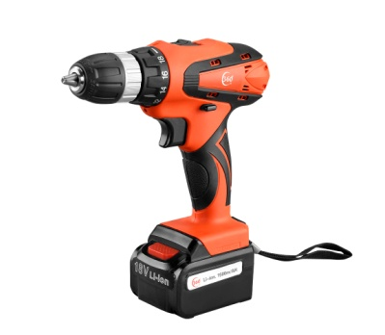
CORDLESS DRILL SERIES (MAKITA) Models
SPECIFICATION | 810-3 | 812-3 | 8812
Volts | 12V MAX | 12V MAX | 12V MAX
Speed Setting | 1 | 2 | 2
Max Rpm | 0-600 rpm | 0-350 / 1,350 rpm | 0-350 / 1,350 rpm
Chuck size | 10mm (3/8") Keyless | 10mm (3/8") Keyless | 10mm (3/8") Keyless
Max Torque | 0-15Nm | 0-10/22Nm | 0-10/22Nm
Charger/Batteries | 1 Hour charger / 1.5Ah Lithium-ion battery （1） | 1 Hour charger / 1.5Ah Lithium-ion battery （1） | 1 Hour charger / 1.5Ah Lithium-ion battery （1）
Includes | BMC | BMC | BMC
Net Weight (With Battery) | 1.0Kg / 2.2 Lbs | 1.0Kg / 2.2 Lbs | 1.1 Kg / 2.4 Lbs
Features |  |  | CLASSIC MAKITA DESIGN
(PRO1.5Ah Battery)
(DIY 1.3Ah Battery)
814-3
16V MAX
2
0-350 / 1,350 rpm
10mm (3/8") Keyless
0-12/26Nm
1 Hour charger / 1.5Ah Lithium-ion battery （1）
BMC
1.15 Kg / 2.5 Lbs
818-3
20V MAX
2
0-350 / 1,350 rpm
10mm (3/8") Keyless
0-13/28Nm
1 Hour charger / 1.5Ah Lithium-ion battery （1）
BMC
1.2 Kg / 2.6 Lbs

Slide 4
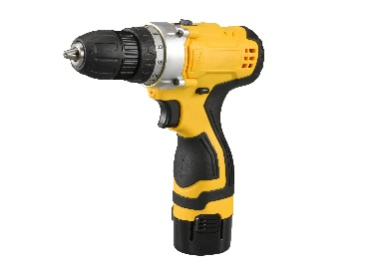
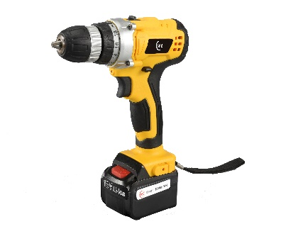
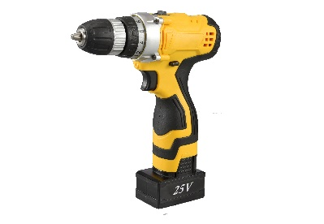
CORDLESS DRILL SERIES 20.16 Models
SPECIFICATION | 8124 | 8145 | 8144
Volts | 12V MAX | 16V MAX | 16V MAX
Speed Setting | 2 | 2 | 2
Max Rpm | 0-350 / 1,350 rpm | 0-350 / 1,350 rpm | 0-350 / 1,350 rpm
Chuck size | 10mm (3/8") Keyless | 10mm (3/8") Keyless | 10mm (3/8") Keyless
Max Torque | 0-10/22Nm | 0-12/26Nm | 0-12/26Nm
Charger/Batteries | Wall plug / chassis charger | Wall plug / chassis charger | Wall plug charger
Includes | BMC | BMC | BMC
Net Weight (With Battery) | 1.0Kg / 2.2 Lbs | 1.15 Kg / 2.5 Lbs | 1.15 Kg / 2.5 Lbs
Features
(PRO1.5Ah Battery)
(DIY 1.3Ah Battery)
8185
20V MAX
2
0-350 / 1,350 rpm
10mm (3/8") Keyless
0-13/28Nm
Wall plug charger
BMC
1.2 Kg / 2.6 Lbs
8186
24V MAX
2
0-350 / 1,350 rpm
10mm (3/8") Keyless
0-16/35Nm
Wall plug / chassis charger
BMC
1.2 Kg / 2.6 Lbs

Slide 5
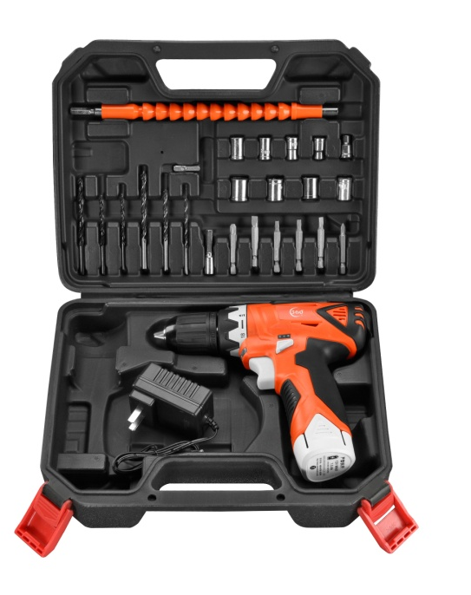
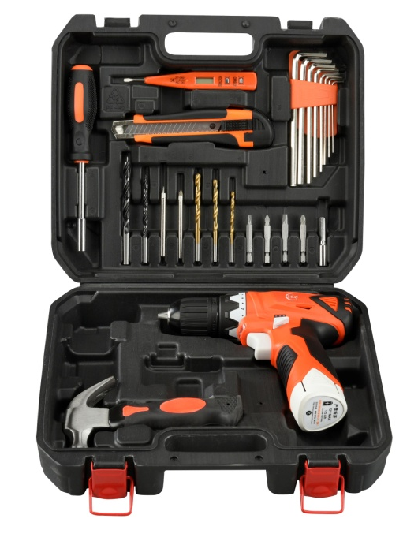
LIGHT DUTY DRILL AND BIT SET
SPECIFICATION | 8107 | 8108 | 8111
PCS included | 13 Pcs | 26 Pcs | 30 Pcs
Dimension | 29*24*8.5cm | 29*24*8.5cm | 30x28x10.5cm
Weight ( includes drill) | 2.2KG / Set | 2.4kg | 2.7kg
Carton | 60*45*26cm / 10 Pcs | 60*45*26cm / 10 Pcs | 57x46x32 cm / 8 Pcs
What’s includes | Flexible Extension shaft Triangle Glass drill bitx2 Brad point drill bitx2 HSS drill bit x2 Masonry drill bitx2 Dual head drive bit Extension bit holder | Flexible Extension shaft Impact Socket 9pcs set Impact socket connector Brad point drill bitx3 HSS drill bit x3 Screw drive bit 6pcs set Extension bit holder | Magnetic bit holder driver Triangle Glass drill bitx2 Brad point drill bitx2 HSS drill bit x3 Screw drive bit 4pcs set Extension bit holder Utility knife Digital display electroprobe Short handle hammer 1.5-6mm Allen key 9pcs sets
(includes 8105 Cordless drill)

Slide 6
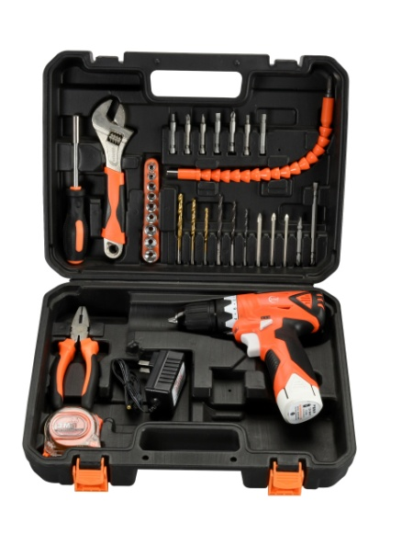
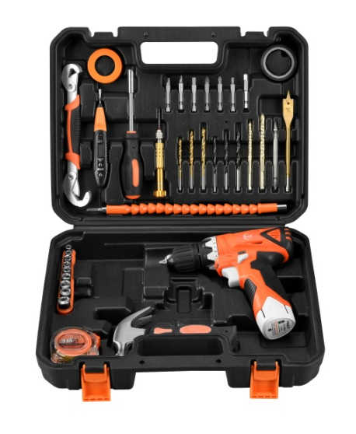
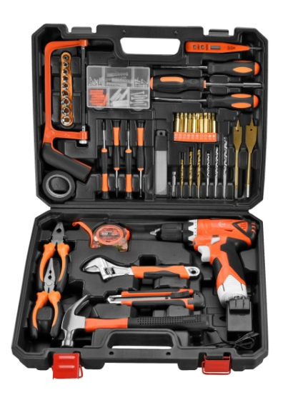
EXTRA DUTY DRILL AND BIT SET
SPECIFICATION | 8109 |  | 8113 |  | 8114
PCS included | 120 Pcs |  | 34 Pcs |  | 45 Pcs
Dimension | 41.5x33.5x9.5cm |  | 36.5 x 28.5 x10.5cm |  | 32.5 x 32.5 x 10cm
Weight ( includes drill) | 4.2kg |  | 3.5kg |  | 3.5 kg
Carton | 51x43x34.5cm / 5 Pcs |  | 64x38x30 cm / 6 Pcs |  | 64x38x30cm / 6 Pcs
What’s includes | Mini Saw Electric resist tape Impact Socket 9pc set Screw driver bit 10pcs set Extension bit holder Digital display electroprobe Flat type screw driver Cross type screw driver Magnetic bit holder driver 2.5/3.0 flat mini screwdriver 2.5/3.0 cross mini screwdriver | Utility knife Blade 5Pcs set HSS drill bit x3 Brad point drill bitx3 16/20mm flat wooden drill bit Cutting pliers Nipper pliers Long handle hammer Adjustable wrench 3M transparent tape Screws set | Flexible Extension shaft Impact Socket 9pcs set Screw drive bit 6pcs set Extension bit holder Magnetic bit holder driver Brad point drill bitx3 HSS drill bit x3 | Masonry drill bitx3 65mm dual drive bit 110mm dual drive bit Adjustable wrench Cutting pliers 3M transparent tape | Universal Wrench Digital display electroprobe Magnetic bit holder driver PTPE Tape Electric resist tape Flexible Extension shaft 6in1 mini screw driver HSS drill bit x3 Brad point drill bit x3 | Multi drill bitx2 20mm flat wooden boring drill bit Screw drive bit 6pcs set Extension bit holder Impact Socket 9pcs set Long handle hammer 3M transparent tape
(includes 8105 Cordless drill)

Slide 7
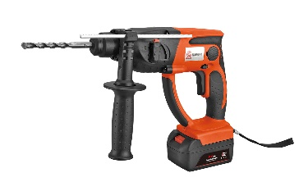
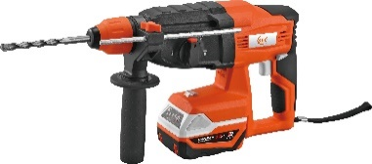
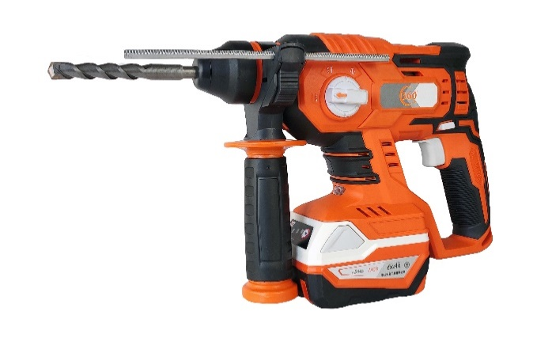
CORDLESS ROTARY HAMMER
SPECIFICATION | 8301 | 8303 | 8305
Volts | 20V MAX | 20V MAX | 20V MAX
Gearbox Actions | 2-Actions | 3-Actions | 3-Actions
Max Rpm | 0-1,300 Rpm | 0-950 Rpm | 0-1,400 Rpm
Impact Per Minute | 0-4,000 IPM | 0-4,700 IPM | 0-5,600 IPM
Drill Ability | 16mm (5/8“) | 26mm (1“) | 20mm(3/4”)
Charger/Batteries | 2 Hour charger / 3Ah Lithium-ion battery (1) | 2 Hour charger / 3Ah Lithium-ion battery (1) | 2 Hour charger / 3Ah Lithium-ion battery (1)
Includes | Side Handle, Depth Gauge, SDS to 13mm Chuck,BMC | Side Handle, Depth Gauge, BMC | Side Handle, Depth Gauge, BMC
Net Weight (With Battery) | 2.6kg | 3.4kg | 2.6kg
Features | Classic Makita Design with 450 W motor | 700W Brushless Motor deliver 2.8 Joules impact energy 3-Actions Gearbox Setting | 400W Brushless Motor deliver 1.8 Joules impact energy 3-Actions Gearbox Setting
P(3.0Ah)

Slide 8
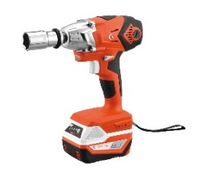
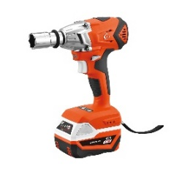
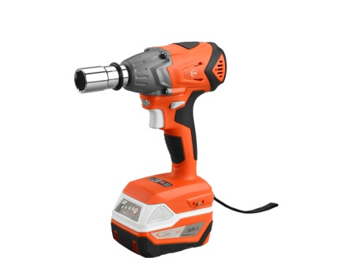
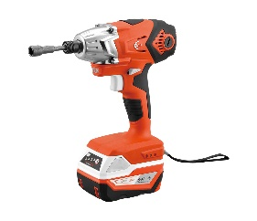
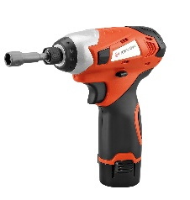
CORDLESS IMPACT WRENCH SERIES 20.17 Models
SPECIFICATION | 8204 | 8203 | 8200x | 8204A | 812-5
Volts | 20V MAX | 20V MAX | 20V MAX | 20V MAX | 12V MAX
Drive Size | 1/2" Square drive anvil with ring | 1/2" Square drive anvil with ring | 1/2" Square drive anvil with ring | 7/16" Hex Quick connector | 7/16" Hex Quick connector
Max Rpm | 0-2,400 Rpm | 0-800/1,600/2,400 Rpm | 0-800/2,400 Rpm | 0-2,400 Rpm | 0-2,000 Rpm
Max Torque | 0- 250 Nm | 0-120/220/320 Nm | 0-250 Nm | 0- 160 Nm | 0-90 Nm
Impact / mins | 0-2,800 Ipm | 0-950/1,900/2,800 Ipm | 0-950/2,800 Ipm | 0-2,800 Ipm | -
Charger/Batteries | 2 Hour charger / 3Ah Lithium-ion battery | 2 Hour charger / 3Ah Lithium-ion battery | 2 Hour charger / 3Ah Lithium-ion battery | 2 Hour charger / 3Ah Lithium-ion battery | 1 Hour charger / 1.5Ah Lithium-ion battery
Includes | Belt hook, M22 impact socket, BMC | Belt hook, M22 impact socket, BMC | Belt hook, M22 impact socket, BMC | Belt hook, M22 impact socket, BMC | BMC
Net Weight (With Battery) | 1.4kg | 1.3kg | 1.3kg | 1.4kg | 0.9kg
Features | Built-in fuel level indicator on battery 1.5/2.0/3.0/4.0/6.0 battery in select New socket conform to other M20 tools | Built-in fuel level indicator on battery 1.5/2.0/3.0/4.0/6.0 battery in select New socket conform to other M20 tools 600W brushless motor | Built-in fuel level indicator on battery 1.5/2.0/3.0/4.0/6.0 battery in select New socket conform to other M20 tools 400W brushless motor | Built-in fuel level indicator on battery 1.5/2.0/3.0/4.0/6.0 battery in select New socket conform to other M20 tools | Light duty and compact size for M6-M10 screw Bolt / nut quick application
(ONE BATTERY + ADDITIONAL)

Slide 9
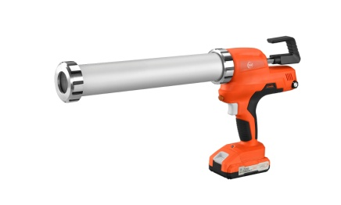
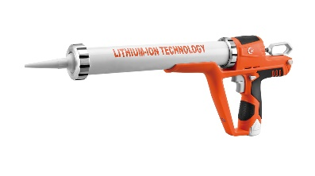
CORDLESS CAULKNG GUN
SPECIFICATION | 8501
Volts | 12V MAX
Speed Setting | 6
Max Pressure force | 0-3,800 N
MM Per Second | 0-6.5 mm/s
Support Material | 300ml catridge / 600ml sausage
Charger/Batteries | 1 Hour charger / 1.5Ah Lithium-ion battery （1）
Includes | Barrel, end ring, piston plate, M10 spanner,Paper box
Net Weight (With Battery) | 1.6kg
Features | Press Power Up to 3,800 N
(1 battery)
8504 | 8504C
20V MAX | 20V MAX
6 | 6
0-6,500 N | 0-6,500 N
0-9.6 mm/s | 0-9.6 mm/s
300ml catridge / 600ml sausage | 300ml catridge
1 Hour charger / 1.5Ah Lithium-ion battery （1） | 1 Hour charger / 1.5Ah Lithium-ion battery （1）
Barrel, end ring, piston plate, M10 spanner,BMC | Barrel, end ring, piston plate, M10 spanner,BMC
1.8kg | 1.8kg
Press Power Up to 6,500 N | Press Power Up to 6,500 N

Slide 10
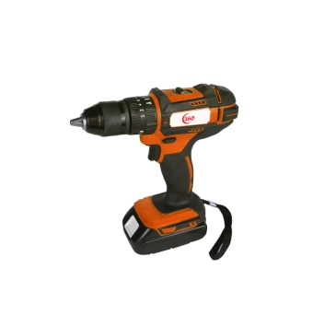
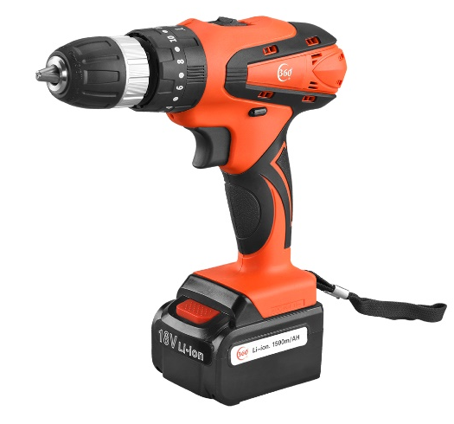
HAMMER DRILL
SPECIFICATION | 8302 | 8818
Volts | 20V MAX | 20V MAX
Speed Setting | 1 | 1
Max Rpm | 0 – 1,800 rpm | 0 – 1,800 rpm
Chuck size | 13mm (1/2") Metal | 13mm (1/2") Metal
Max Torque | 0-70Nm | 0-70Nm
Charger/Batteries | 1 Hour charger / 1.5Ah Lithium-ion battery （1） | 1 Hour charger / 1.5Ah Lithium-ion battery （1）
Includes | BMC | BMC
Net Weight (With Battery) | 1.4 Kg / 3.0 Lbs | 1.4 Kg / 3.0 Lbs
Features |  | 840 motor up to 400W output Hammer action design Built-in fuel level indicator on battery 2.0/3.0/4.0/6.0 battery in select New socket conform to other M20 tools 400W brushless motor

Slide 11
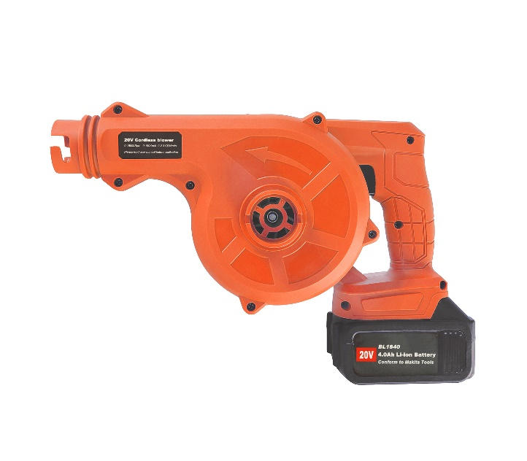
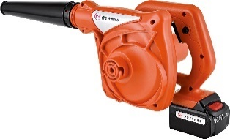
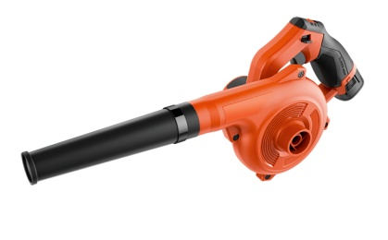
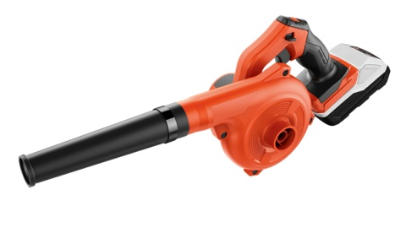
CORDLESS BLOWER
SPECIFICATION | 814-5 | 818-5 | 8146
Volts | 16V MAX | 20V MAX | 16V MAX
Speed Setting | 1 | 1 | 3
Max Rpm | 0-15,000 rpm | 0-18,000 rpm | 0-4,000/12,000/18,000 Rpm
Air Volume | 60CFM | 75CFM | 80CFM
Max. Air Velocity | 130 KMH | 160 KMH | 200 KMH
Charger/Batteries | 1 Hour charger / 1.5Ah Lithium-ion battery （1） | 1 Hour charger / 1.5Ah Lithium-ion battery （1） | 1 Hour charger / 1.5Ah Lithium-ion battery （1）
Includes | Nozzle, Dust Bag, Color box | Nozzle, Dust Bag, Color box | Nozzle, Dust Bag, Color box
Net Weight (With Battery) | 1.2kg | 1.3kg
Features | Air and Liquid extraction | Air and Liquid extraction 2.0/3.0/4.0/6.0 Battery in select | THREE SPEED SETTING UPDATED HOUSING 20% worklife improved 30% AIR power improved
(1 battery)
8187
20V MAX
3
0-4,000/12,000/18,000 Rpm
90CFM
220 KMH
1 Hour charger / 2.0Ah Lithium-ion battery （1）
Nozzle, Dust Bag, Color box
THREE SPEED SETTING UPDATED HOUSING 20% worklife improved 30% AIR power improved

Slide 12
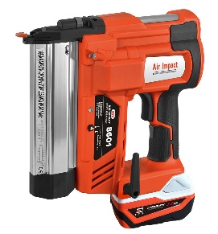
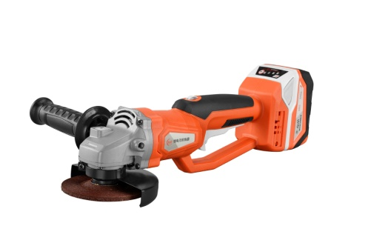
CORDLESS NAILER
SPECIFICATION | 8601
Volts | 20V MAX
Support Nail | F shape 50 max / K sharp 40 max
max magazine | 100 Nails
Shot per Minute | 60 Nails Max
Worklife | 900 Shots per charge
Charger/Batteries | 1.5 Hour charger (32W) / 2Ah Lithium-ion battery (1)
Includes | Spanner , BMC
Net Weight (With Battery) | 3.6kg
Features | Support bradly nail and staple
(1 battery)
CORDLESS ANGLE GRINDER
SPECIFICATION | 8401
Volts | 20V MAX
No-load speed | 0-7500 Rpm
Output Shaft | M10 (100mm) / M14(115/125mm)
Speed adjustment | variable speed
motor | 700W max brushless motor
Charger/Batteries | 2 Hour charger (32W) / 3Ah Lithium-ion battery (1)
Includes | Spanner , Disk Guard , Side handle, BMC
Net Weight (With Battery) | 1.8kg
Features | Brushless motor 200% worklife
(1 battery)
CORDLESS RATCHET WRENCH
SPECIFICATION | 8126
Volts | 12v max
No-load speed | -
Output Shaft | 3/8”
Speed adjustment | variable speed
torque | 0-
Charger/Batteries | 2 Hour charger (32W) / 3Ah Lithium-ion battery (1)
Includes | Spanner , Disk Guard , Side handle, BMC
Net Weight (With Battery) | 1.8kg
Features | Brushless motor 200% worklife
Price (1 battery)

